Slide 1
Programming Fundamentals
Course Code: CS-111
Course Instructor: Isra Naz

Slide 2
Example
Write a program that inputs dividend and divisor. It then calculates and displays the quotient and remainder.
int main()
{
int div, dis, q, r;
cout<<“Enter dividend & divisor:”;
cin>>div>>dis;
q=div/dis;
r=div%dis;
cout<<“Quotient=“<<q<<endl;
cout<<“Remainder=“<<r<<endl;
}

Slide 3
 C++ also provides two unary operators for
adding 1 to value of a variable or
subtracting 1 from the value of a numeric variable.
These are the
unary increment operator ++
unary decrement operator --

Slide 4
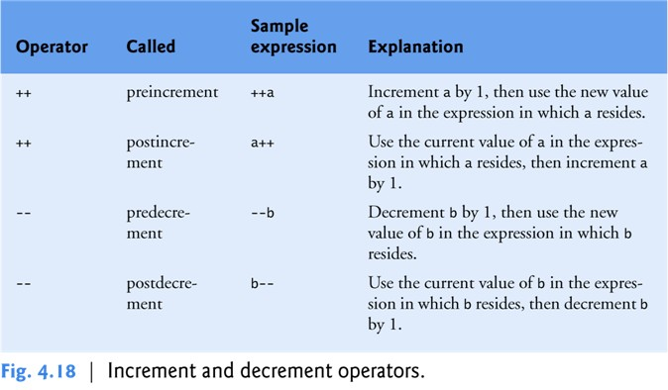

Slide 5
Example
Output:
value of c = 10
value of c = 11
value of c = 11
value of c = 11
value of c = 12
int main()
{
int c = 10;
cout<< “value of c = “<< c <<endl;
cout<< “value of c = “<< ++c <<endl;
cout<< “value of c = “<< c <<endl;
cout<< “value of c = “<< c++<<endl;
cout<< “value of c = “<< c <<endl;
}

Slide 6
Example
Output:
10 , 16
int x=10, y=15;
x = x++;
y = ++y;
cout<<x<< “, “ <<y;

Slide 7
Example
Output:
10
int n = 10;
int x = 0;
x = n--;
cout<<x<<endl;

Slide 8
Tasks
a) Write a C++ program to add 3 integers or float.
b) Write a C++ program to Compute quotient and remainder.
c) Take two integers as input from the user and apply arithmetic operations on them (+,-,*, /) and print them on screen
d) Write a program to convert 45 centigrade temperature into Fahrenheit using the formula F=9/5 (C+32) and displays the temperature in Fahrenheit
e) Take two numbers as input from the user and swap numbers using a Temporary Variable. Show the values before and after.

Slide 9
Goals for today:
Control flow statements
If
If-else
If-else-if/Nested if
Conditional statements

Slide 10
Control Structure
A statement used to control the flow of execution in a program is called control structure
The instructions in a program can be organized in three kinds of control structures to control execution flow
Sequential structure
Selection structure
Repetition

Slide 11
Control Flow statements
Control statements cause the flow of execution to advance and branch based on the changes to the state of the program.
Control statements are divided into three groups:
selection statements allow the program to choose different parts of the execution based on the outcome of an expression
iteration statements enable program execution to repeat one or more statements
jump statements enable your program to execute in a non-linear fashion

Slide 12
Decision Statements
In a program, a decision causes a one-time jump to a different part of the program, depending on the value of the expression.
In C++ decision can be made in several ways:
If statement
If . . Else statement
Switch statement

Slide 13

It is used to execute (or ignore) a set of statements after testing a condition.
If the condition evaluates to true the statement (or set of statements) following the if statement is executed.
If the condition is false then the statement (or set of statements) following the if statement is ignored and control transfers to next statement.

Slide 14
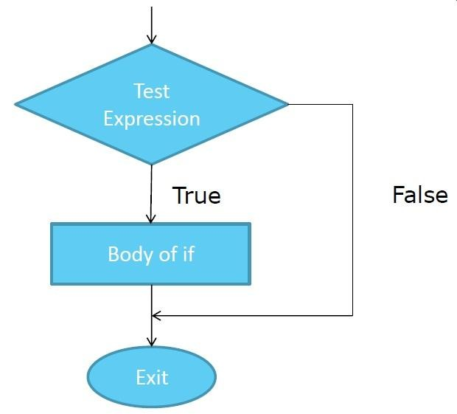

Slide 15
 Single-line if statement: The syntax of single line
if statement is
if (condition) statement;
 Multi-line if statement: The syntax of “if
statement” for executing a set of statements is
if (condition)
{
statement-1;
statement-2;
.
.
statement-n;
The statements in curly brackets are also known as compound statements
}

Slide 16
# include<iostream> int main ( )
{
int a, b;
a=100; b=10;
If (a > b)
cout<<a<< “ is bigger than ” << b; return 0;
}

Slide 17

If-else consists of one condition and two blocks of statements.
If condition is true the statements in the if block is executed and if condition is false the statements in the else block are executed.
 Following is the syntax
if (condition) statement;
else
statement;

Slide 18
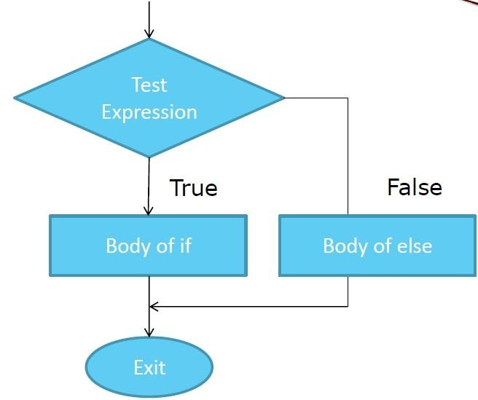

Slide 19
// if-else with single statement in body
# include<iostream> int main ( )
{
int a, b; a=100; b=10;
if (a > b)
cout<<a<< “ is bigger than ” << b;
else
cout<<b<< “ is bigger than ” << a; return 0;
}

Slide 20
// if-else with multiple statements in body # include<iostream>
int main ( )
{
int a, b; a=100; b=10;
if (a > b)
{
cout<<“We have two integers a and b in this program \n”;
cout<<a<< “ is bigger than ” << b;
}
else
{
cout<<“We have two integers a and b in this program \n”; cout<<b<< “ is bigger than ” << a;
}
return 0;
}

Slide 21
Task
Write a program to input a number. If the number is divisible by 3 then print the message on the screen that ‘the number is divisible by three’.

